Slide 1
Introduction to Intermediate Machine Learning: From Theory to Practice with Random Forests, Extreme Gradient Boosting and Adaptive Boosting Prepared and Delivered: Lumumba Wandera Victor

Slide 2
SESSION ONE
THEORETICAL FOUNDATION OF BAGGING, BOOSTING AND STACKING

Slide 3
INTRODUCTION TO ENSEMBLE LEARNING
What is Ensemble Learning?
Ensemble Learning is a powerful machine learning paradigm where multiple models, often called base learners or weak learners, are trained and combined to solve the same problem. The core idea is that a group of models working together can produce more accurate, robust, and generalizable predictions than a single model acting alone.
The ensemble approach is inspired by the concept of the “wisdom of the crowd” — combining multiple opinions can lead to better decisions, especially when the individuals have diverse perspectives.

Slide 4
Why Use Ensemble Learning?
Ensemble methods are popular in machine learning because they:
Improve accuracy: They often outperform individual models in both classification and regression tasks.
Reduce overfitting: By averaging or voting over multiple models, they can reduce the risk of overfitting, especially in high-variance models.
Enhance generalization: Ensembles often generalize better to unseen data.
Stabilize predictions: They reduce the influence of noise or outliers in the dataset.

Slide 5
The Concepts of Ensemble Learning
In the machine learning paradigm known as “ensemble learning,” several models — often referred to as “weak learners” — are taught to tackle a single problem and then integrated to produce better outcomes. The fundamental idea of ensemble learning is that a collection of incompetent learners might combine to become a strong learner, improving prediction accuracy. When compared to single-model approaches, ensemble methods can be particularly effective at lowering variance, bias, or improving predictions.
There are various ensemble approaches, and each combines models in a different way. The most typical kinds consist of:

Slide 6
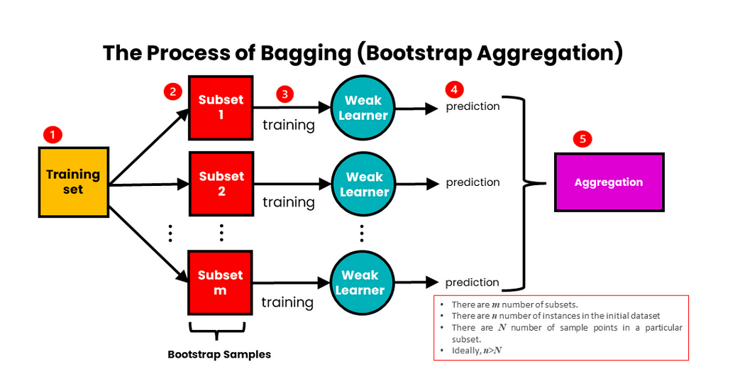
Bagging (e.g. Random Forest)

Slide 7
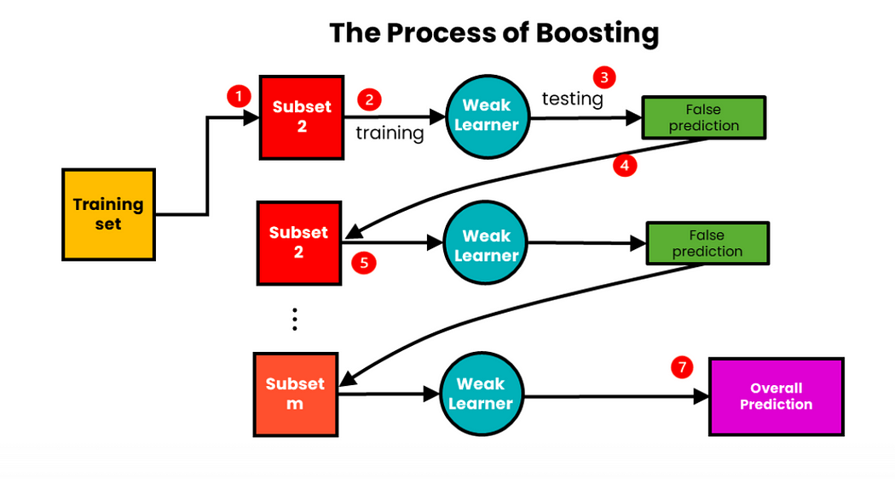
Boosting (e.g. Extreme Gradient Boosting)

Slide 8
Introduction to Stacking
Stacking, also known as stacked generalization, is the process of training several models on the same set of data, followed by the training of a meta-model to produce a final prediction that is based on the earlier models’ predictions.
Here are the steps involved in stacking:
We train m-number of algorithms using the original training set of data. Every algorithm’s output is used to generate a fresh training set.
We develop a meta-model algorithm with the fresh training set. Our ultimate forecast is based on the meta-model’s findings. Weighted averaging is utilized to aggregate the outcomes.

Slide 9
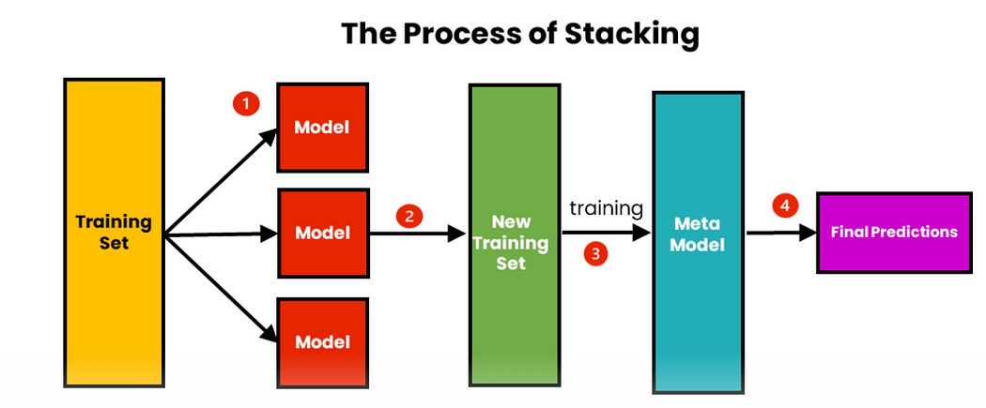
Stacking Illustration

Slide 10
Types of Ensemble Learning Methods
Ensemble learning can be broadly classified into the following types:
Bagging (Bootstrap Aggregating)
Trains multiple models on different random subsets of the training data (with replacement).
Aggregates predictions through majority voting (classification) or averaging (regression).
Example: Random Forest
Boosting
Trains models sequentially, where each new model tries to correct the errors of the previous ones.
Gives more weight to misclassified instances.
Examples: AdaBoost, Gradient Boosting, XGBoost
Stacking (Stacked Generalization)
Combines the predictions of multiple base learners using a meta-learner.
Base models are trained in parallel and their outputs are used as input features to train the final model.

Slide 11
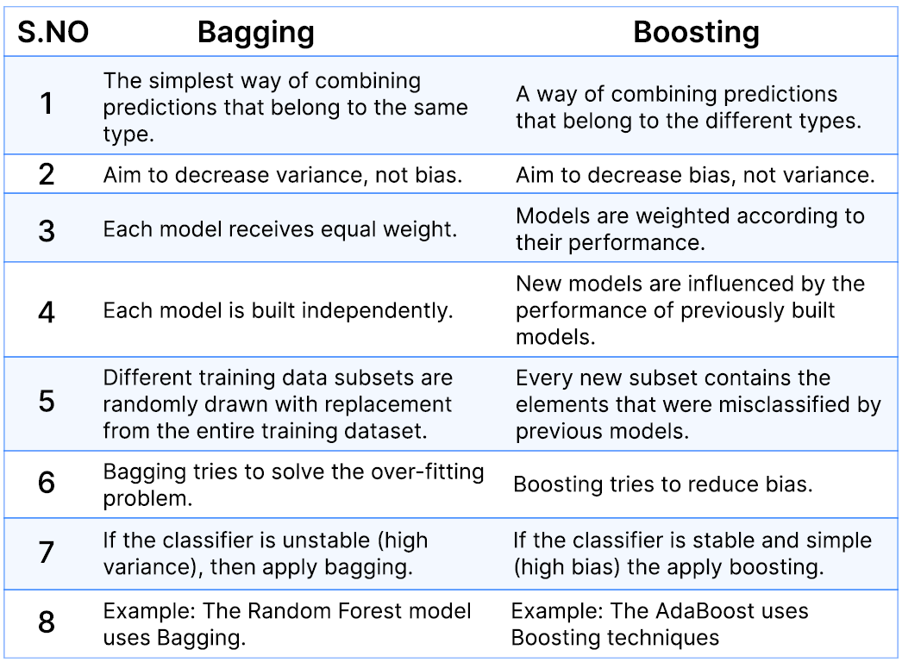
Comparison of Bagging and Boosting

Slide 12
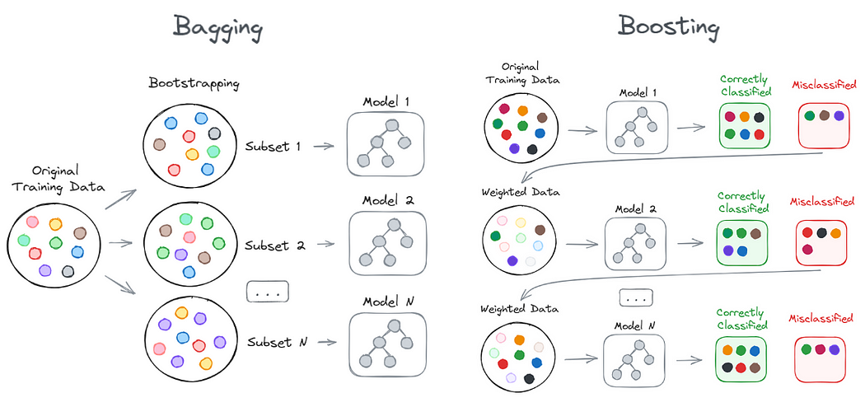
Diagrammatic Illustration of Bagging and Boosting

Slide 13
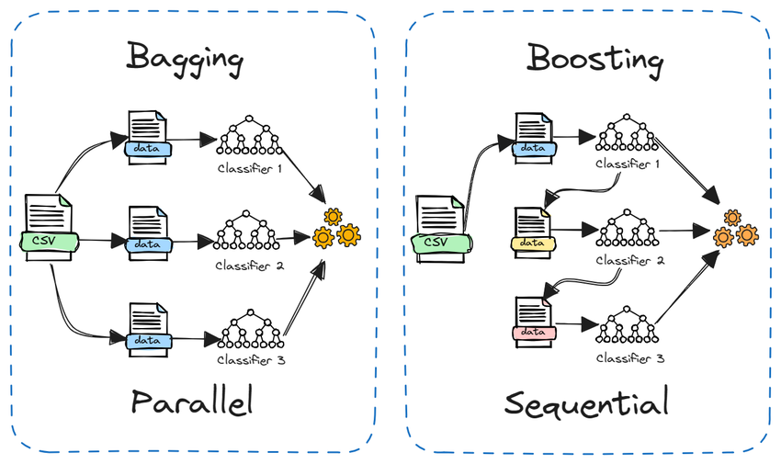
Bagging and Boosting Illustration

Slide 14
Key Concepts in Ensemble Learning
Weak Learner: A model that performs slightly better than random guessing (e.g., decision stump).
Strong Learner: A model that achieves high accuracy, usually built by combining many weak learners.
Diversity: The effectiveness of an ensemble depends on the diversity of the base learners. If all models make the same mistakes, the ensemble offers no improvement.
Bias-Variance Trade-off: Ensembles aim to reduce variance (Bagging) and bias (Boosting), leading to better generalization.

Slide 15
Bias and Variance Trade Off

Slide 16
Continuation of Bias Variance Trade Off

Slide 17
Applications of Ensemble Learning
Ensemble methods are widely used in:
Financial risk modeling
Medical diagnosis
Credit scoring
Image and speech recognition
Fraud detection
Competitions like Kaggle (almost all winning solutions use ensemble techniques)

Slide 18
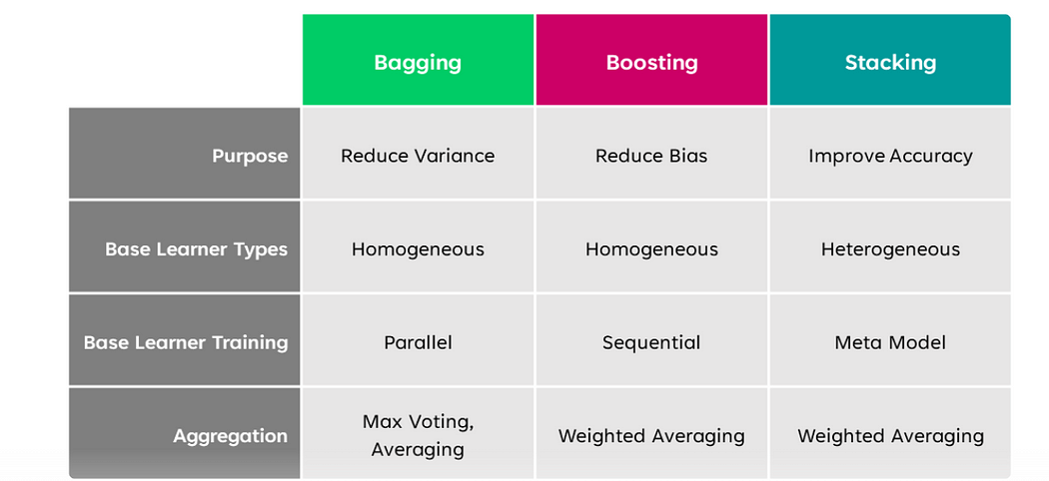
When to use Bagging vs Boosting vs Stacking?

Slide 19
SESSION TWO
PRE-REQUISITE TO BAGGING AND BOOSTING IMPLEMENTATION IN R SOFTWARE
Data Collection
Data Preparation (at least five steps)
Train and Test Split
Cross Validation (Repeated CV, CV and LOOCV)

Slide 20
Data Collection
Data collection is the foundational step in any machine learning pipeline. It involves gathering relevant data that will be used to train and test your model. For ensemble methods like Bagging and Boosting, high-quality and representative data is crucial to model performance.
Purpose of Data Collection
To obtain a dataset with sufficient features (predictors) and outcomes (target variable).
To ensure data is representative of the real-world scenario the model will face.
To allow for effective training, validation, and testing of ensemble models.

Slide 21
Sources of Data
1 Open Datasets
UCI Machine Learning Repository (https://archive.ics.uci.edu)
Kaggle Datasets (https://www.kaggle.com/datasets)
R packages with built-in datasets: mlbench, caret, MASS, datasets
2. APIs and Web Scraping
Use httr, rvest, or jsonlite packages to collect data from web services and APIs.
3. Databases and Spreadsheets
SQL databases, Excel files, Google Sheets (use readxl, DBI, googlesheets4)
4. Survey or Experimental Data
Data collected via surveys, experiments, or field work.

Slide 22
Example in R: Loading a Built-in Dataset
For educational purposes, let's use the Sonar dataset from the mlbench package:
Load required package
library(mlbench)
data(iris) or
htn_dat = read.csv("htn_dat.csv")
head(htn_dat)
View the structure of the dataset
str(htn_dat)

Slide 23
Best Practices in Data Collection
Ensure data privacy and ethical considerations (especially with sensitive data).
Validate data quality: check for completeness, consistency, and accuracy.
Ensure data is in a machine-readable format (CSV, Excel, JSON, etc.).
Once data is collected, the next step is data preparation, where you clean and structure the data for modeling. Let me know when you're ready for notes on that section.

Slide 24
Data Preparation
Proper data preparation is essential for building accurate and reliable ensemble models such as Random Forests, AdaBoost, and XGBoost. This stage involves cleaning, transforming, and structuring data to ensure it's ready for model training and evaluation.
Step 1: Handling Missing Values
Identify and address any missing data within the dataset.
Common strategies include deletion (if missingness is minimal) or imputation using the mean, median, or predictive methods.
Proper handling of missing values prevents biased models and ensures algorithm stability.
Step 2: Removing Zero-Variance and Near-Zero Variance Predictors
Predictors with little or no variability provide no meaningful information for classification or regression tasks.
These variables can be removed to reduce computational cost and improve model interpretability.

Slide 25
Data Preparation
Step 3: Feature Scaling
Standardization (zero mean, unit variance) or normalization (rescaling to a fixed range) ensures all features contribute equally.
While tree-based models like Random Forests are less sensitive to scaling, boosting algorithms (like XGBoost) often benefit significantly.
Step 4: Encoding Categorical Variables
Ensure that the target variable is properly encoded as a factor (for classification) or numeric (for regression).
For input variables, use encoding techniques such as label encoding or one-hot encoding where applicable.
Step 5: Outlier Detection and Treatment
Outliers can distort model learning, especially in boosting techniques that are sensitive to noise.
Identify outliers using visual tools (e.g., boxplots) or statistical rules (e.g., IQR), and treat them through methods like trimming, capping, or transformation.

Slide 26
Data Preparation
Step 6: Addressing Class Imbalance (If Applicable)
When one class significantly outweighs others, the model may become biased.
Apply resampling techniques such as over-sampling the minority class, under-sampling the majority class, or using synthetic methods like SMOTE.
Step 7: Feature Engineering (Optional)
Create new features from existing ones to improve model performance.
Techniques include interaction terms, polynomial features, log transformations, or domain-specific indicators.

Slide 27
TRAIN AND TEST SPLIT
The train-test split is a fundamental step in the machine learning workflow. It involves dividing the dataset into two subsets: one for training the model and another for testing or validating its performance.
Typical Split Ratios
70/30: 70% training, 30% testing (commonly used).
80/20: Slightly more training data for better model learning.
60/40 or 90/10: Depending on data size and use case.
For small datasets, preserving enough test data is crucial for valid evaluation

Slide 28
Stratification (For Classification Tasks)
Ensures that the proportion of classes in the training and testing sets reflects the original dataset.
Prevents bias caused by class imbalance during splitting.
Best Practices
Perform train-test split after cleaning and preprocessing the data.
Set a random seed for reproducibility.
Avoid using test data during training to maintain model integrity.
Ensure that the test set remains untouched until final model evaluation
Limitations
A single train-test split may not give a reliable estimate of model performance.
Performance can vary depending on how the data is split — this is addressed in Cross-Validation, which is the next step.

Slide 29
Cross-Validation Techniques
Cross-validation is a statistical method used to estimate the skill of machine learning models.
It is particularly useful when the dataset is small, as it helps ensure that the model is trained and tested multiple times on different subsets of the data.

Slide 30
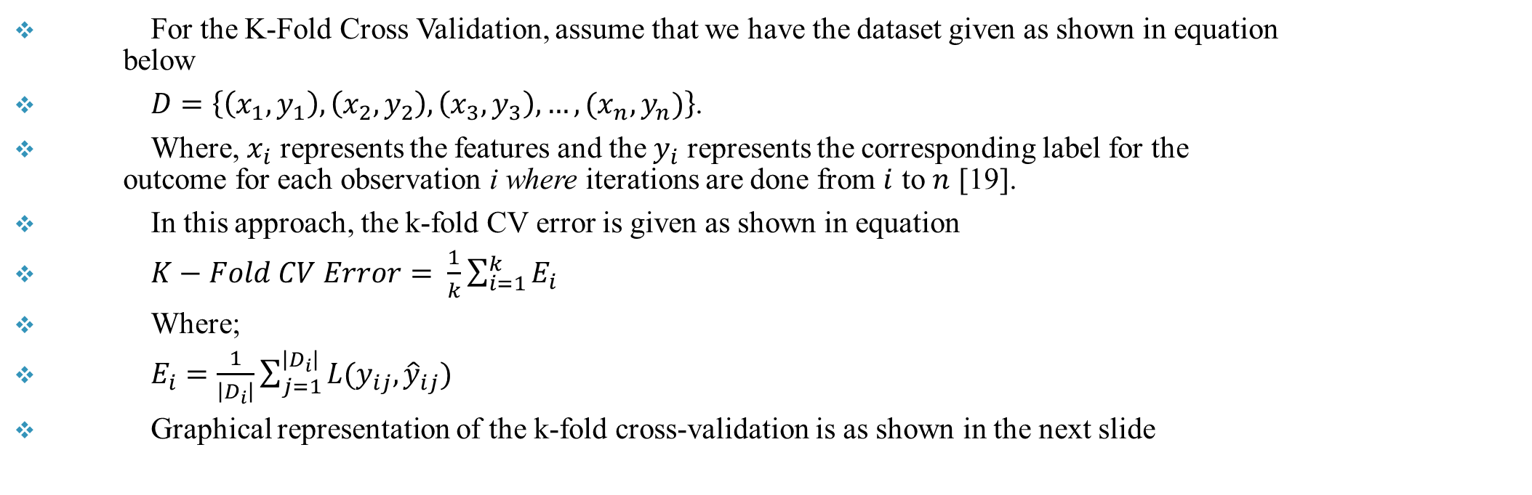
K-Folds Cross Validation
For the K-Fold Cross Validation, assume that we have the dataset given as shown in equation below
$D=\left\{\left(x_{1},y_{1}\right), \left(x_{2},y_{2}\right),\left(x_{3},y_{3}\right),…,(x_{n},y_{n})\right\}$.
Where, $x_{i}$ represents the features and the $y_{i}$ represents the corresponding label for the outcome for each observation i where iterations are done from $i$ to $n$ [19].
In this approach, the k-fold CV error is given as shown in equation
$K−Fold CV Error= \frac{1}{k}\sum_{i=1}^{k}{E_{i}}$
Where;
$E_{i}=\frac{1}{\left|D_{i}\right|}\sum_{j=1}^{\left|D_{i}\right|}{L(y_{ij},{\hat{y}}_{ij})}$
Graphical representation of the k-fold cross-validation is as shown in the next slide

Slide 31
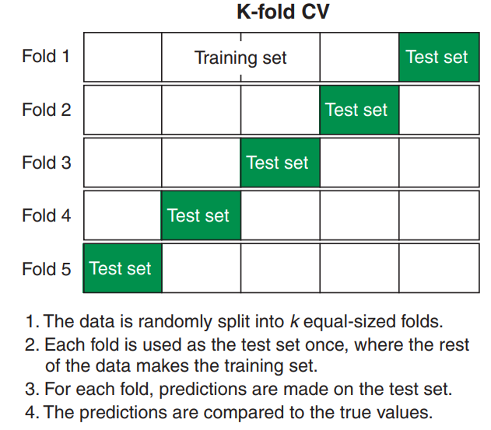
Graphical Representation of K-Folds CV

Slide 32
Repeated K-Folds Cross Validation
The repeated k-fold cross-validation is an extension of k-fold cross-validation.
Repeated k-fold cross-validation provides a way to improve the estimated performance of a machine-learning model.
The technique involves simply repeating the cross-validation procedure multiple times and reporting the mean result across all folds from all runs .

Slide 33
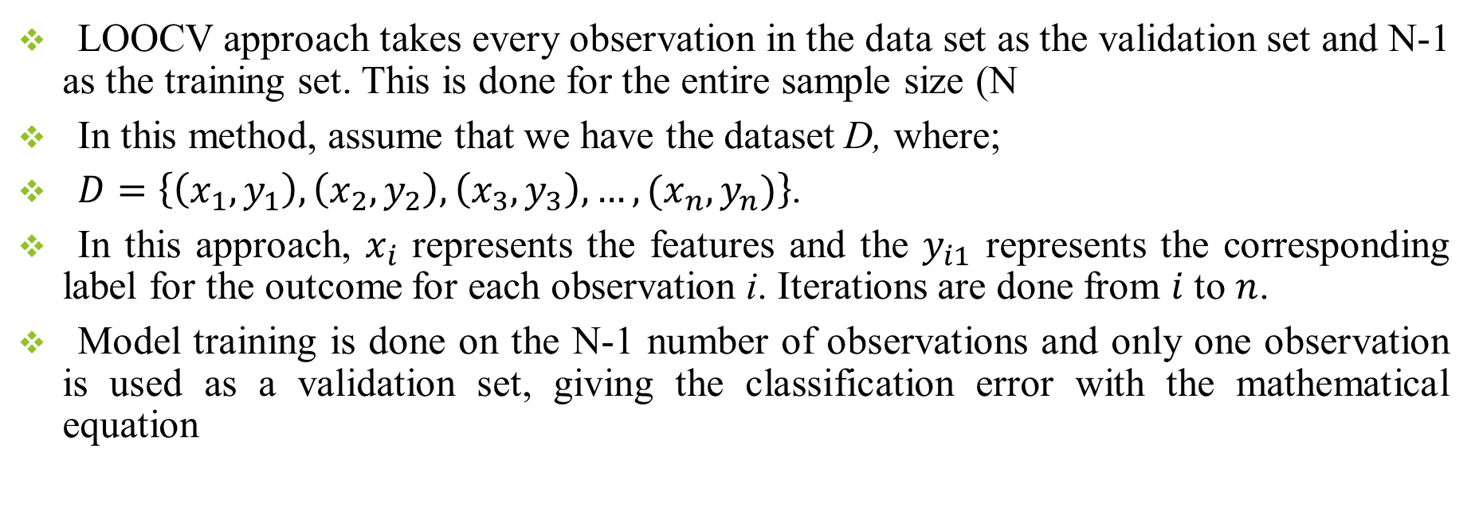
Leave One Out Cross Validation (LOOCV)
LOOCV approach takes every observation in the data set as the validation set and N-1 as the training set. This is done for the entire sample size (N
In this method, assume that we have the dataset D, where;
$D=\left\{\left(x_{1},y_{1}\right), \left(x_{2},y_{2}\right),\left(x_{3},y_{3}\right),…,(x_{n},y_{n})\right\}$.
In this approach, $x_{i}$ represents the features and the $y_{i1}$ represents the corresponding label for the outcome for each observation i. Iterations are done from $i$ to $n$.
Model training is done on the N-1 number of observations and only one observation is used as a validation set, giving the classification error with the mathematical equation

Slide 34
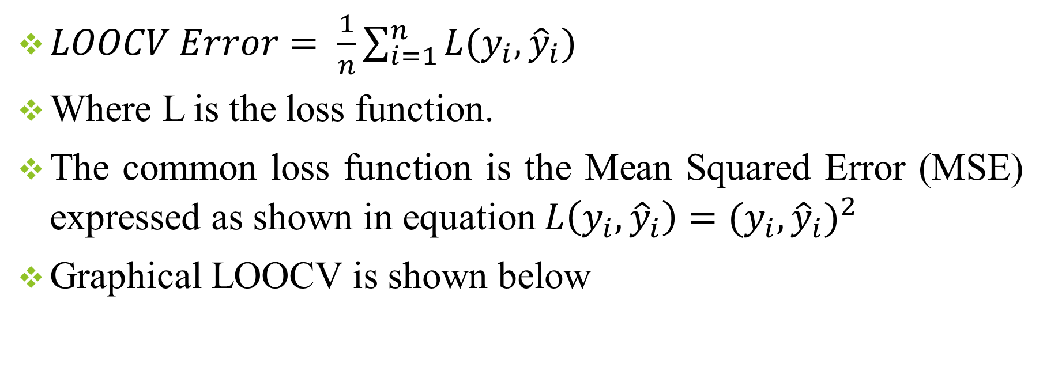
LOOCV cont’
$LOOCV Error= \frac{1}{n}\sum_{i=1}^{n}{L(y_{i},{\hat{y}}_{i})}$
Where L is the loss function.
The common loss function is the Mean Squared Error (MSE) expressed as shown in equation $L\left(y_{i},{\hat{y}}_{i}\right)={(y_{i},{\hat{y}}_{i})}^{2}$
Graphical LOOCV is shown below

Slide 35
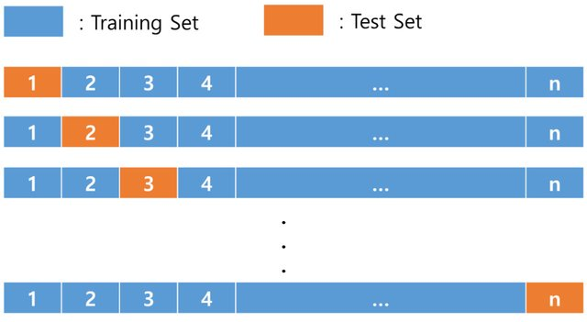
Graphical Representation of LOOCV

Slide 36
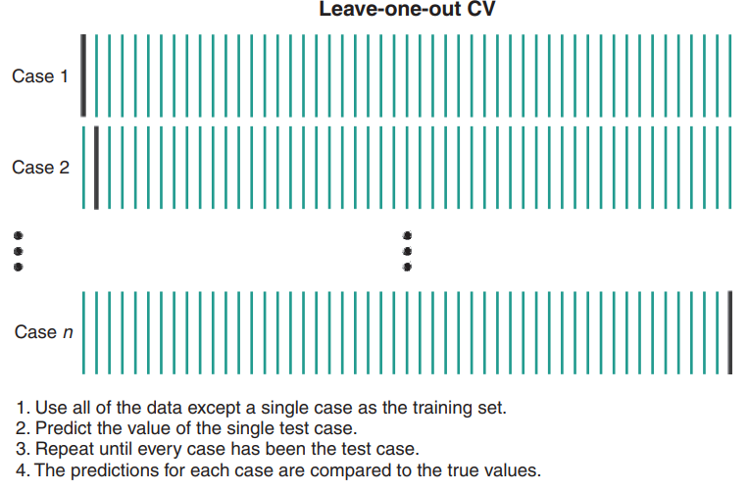
Alternative LOOCV Visual

Slide 37
SESSION THREE
IMPLEMENTATION OF RANDOM FOREST AND EXTREME GRADIENT BOOSTING MODEL
Training the Model
Model Evaluation

Slide 38
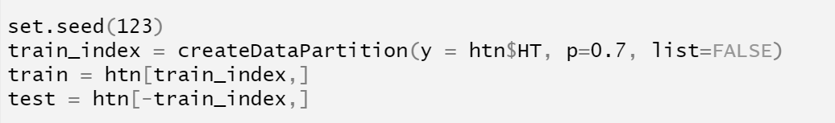
Data Partitioning
The code provided performs a train-test split on the htn dataset using stratified sampling. First, set.seed(123) ensures that the results are reproducible every time the code is run.
The createDataPartition() function, from the caret package, is used to generate indices for a training set that maintains the same proportion of the target variable HT as in the original dataset.
The argument p = 0.7 specifies that 70% of the data should be allocated to the training set. Setting list = FALSE ensures the result is returned as a vector of row indices.
The train set is created using these indices, and the remaining 30% of the data forms the test set for model evaluation.

Slide 39
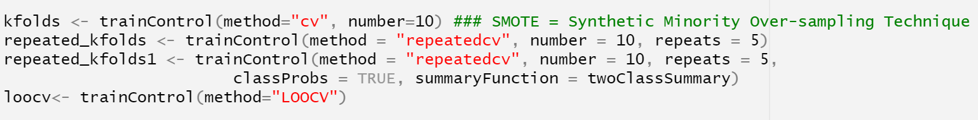
Create the Cross Validation Scheme
The code defines different cross-validation strategies using the trainControl() function from the caret package in R to evaluate model performance. The first line, kfolds, specifies 10-fold cross-validation, where the dataset is split into 10 subsets, and the model is trained and validated 10 times, each time using a different fold as the validation set.
The second line, repeated_kfolds, uses repeated 10-fold cross-validation, where the 10-fold process is repeated 5 times to improve the reliability of performance estimates.
The third line, repeated_kfolds1, extends the previous method by also enabling class probability estimation (classProbs = TRUE) and performance summary using metrics such as ROC, Sensitivity, and Specificity (summaryFunction = twoClassSummary), which is useful for classification tasks.
Finally, loocv defines Leave-One-Out Cross-Validation (LOOCV), where each observation is used once as the test set while the rest form the training set—ideal for small datasets but computationally expensive for large ones.

Slide 40
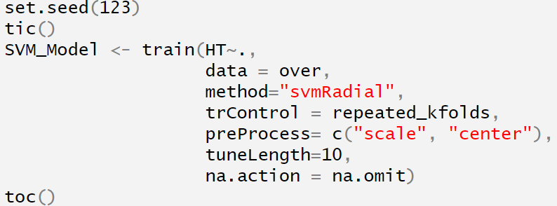
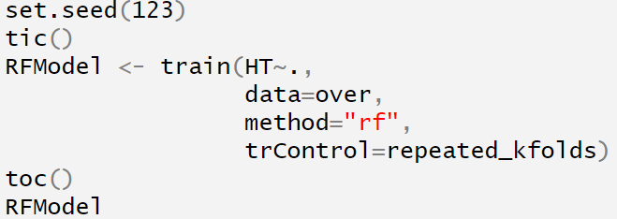
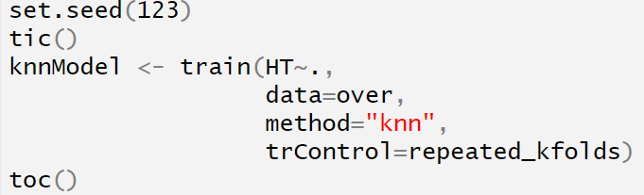
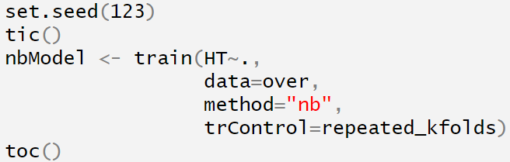
Train the Machine Learning Models
Support Vector Machines
Random Forest
K-Nearest Neighbors
Naïve Bayes

Slide 41
Model Performance Evaluation
Performance Evaluation Metrics | SVM | KNN | RF | NB
Accuracy | 0.9220 | 0.8690 | 0.9220 | 0.8950
No Info Rate | 0.8710 | 0.8710 | 0.8710 | 0.8710
Kappa | 0.5370 | -0.0030 | 0.5370 | 0.3090
Sensitivity | 0.4000 | 0.0000 | 0.4000 | 0.2110
Specificity | 1.0000 | 0.9980 | 1.0000 | 0.9970
Precision | 1.0000 | 0.0000 | 1.0000 | 0.9050
F1-Score | 0.5710 | NaN | 0.5710 | 0.3420
Balanced Accuracy | 0.7000 | 0.4990 | 0.7000 | 0.6040
AUC | 0.7090 | 0.5470 | 0.7600 | 0.7770

Slide 42
Discuss the Results
The performance evaluation metrics for Support Vector Machine (SVM), K-Nearest Neighbors (KNN), Random Forest (RF), and Naive Bayes (NB) classifiers reveal notable differences in predictive capability. Both SVM and RF achieved the highest accuracy of 92.2%, outperforming KNN (86.9%) and NB (89.5%).
However, accuracy alone is insufficient due to the class imbalance suggested by the No Information Rate (87.1%), which all models needed to surpass to be considered useful. The kappa statistic, which accounts for agreement by chance, was highest for SVM and RF (0.537), indicating moderate agreement, while KNN performed poorly with a negative kappa (-0.003), suggesting random or misleading predictions.
Sensitivity, which measures the true positive rate, was low across all models, especially for KNN (0.000) and NB (0.211), highlighting difficulty in detecting the minority class. In contrast, all models exhibited high specificity, with SVM and RF reaching 1.000, indicating perfect true negative identification.
Precision was perfect for SVM and RF, but KNN failed to correctly classify any positive cases. The F1-score, a balance between precision and recall, was highest for SVM and RF (0.571), while KNN was undefined due to zero true positives. Notably, NB achieved the highest AUC (0.777), indicating strong overall discriminative ability. Thus, despite slightly lower accuracy, NB may be the most balanced performer.

Slide 43
SESSION FOUR
HYPERPARAMETER TUNING AND MODEL DEPLOYMENT
Hyperparameter Optimization
Model Deployment

